Slide 1

Capstone Project 2
Generation artificial MRI images by style transfer using Cycle GAN(modified Unet)
by Akshay kumar

Slide 2
Overview of Cycle GAN
Generative Adversarial Models, or GANs, are a class of artificial intelligence algorithms used in unsupervised machine learning. They are made up of two neural networks and can be used to generate artificial data.
CycleGAN, short for Cycle-Consistent Generative Adversarial Networks, is a type of deep learning model used for image-to-image translation.
CycleGAN is designed to learn mappings between two different domains without the need for paired data, meaning that It can learn translations between two sets of images even when there is no direct correspondence between individual images in the two domains.
CycleGAN consists of two main components:
Generator Networks: These networks learn the mapping from one domain to another and vice versa. In the case of image-to-image translation, there are typically two generators: one for translating images from domain A to domain B and another for translating images from domain B to domain A.
Discriminator Networks: These networks distinguish between real and generated images. They help to train the generator networks by providing feedback on how realistic the generated images are.
During training, the generator networks aim to minimize the difference between the translated images and the real images in both domains, while the discriminator networks aim to distinguish between real and generated images. Additionally, the cycle consistency loss encourages the generators to produce images that are consistent when translated back and forth between the two domains.

Slide 3
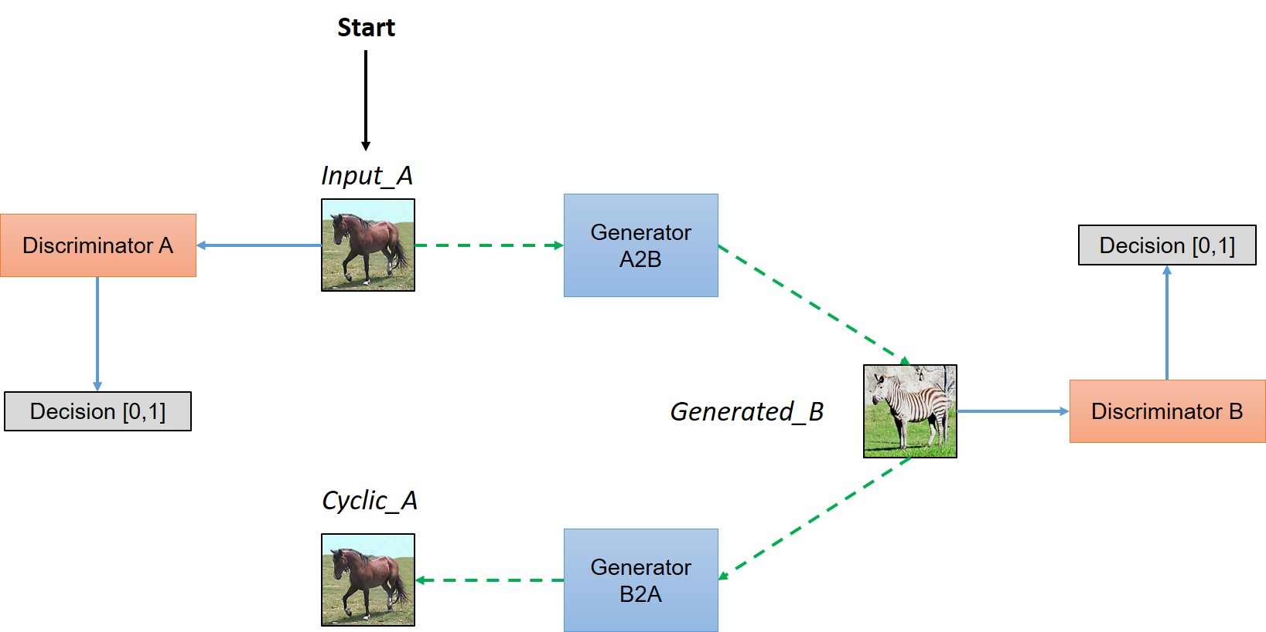

Slide 4
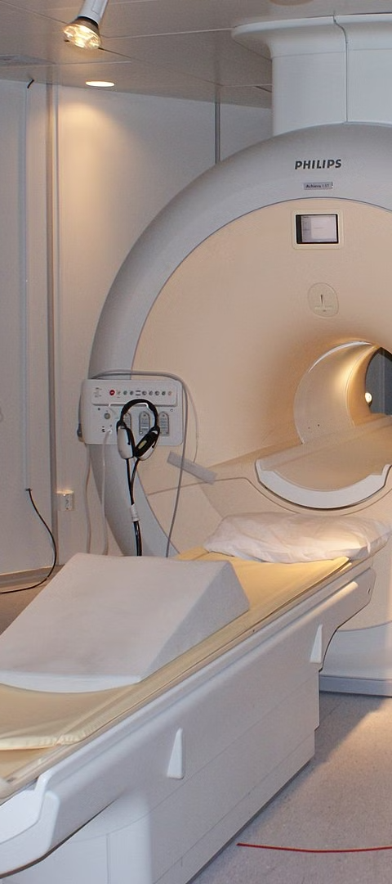
Overview of MRI imaging and contrast levels
1
MRI Basics
MRI, Magnetic Resonance Imaging, is a medical imaging technique used to visualize internal structures of the body in detail.
2
Contrast Enhancement
Contrast levels in MRI imaging refer to the brightness differences between different tissues or diseases, highlighting certain areas for better diagnosis.
3
Types of Contrast
MRI can use different types of contrast, such as T1-weighted or T2-weighted imaging, to show different tissue characteristics.

Slide 5
Challenges in generating artificial MRI images
1
Data Complexity
2
Noise Reduction
3
Contrast Variation
MRI data is complex and high-dimensional, making it challenging to accurately replicate using generative models.
Removing noise from MRI images is crucial, and generating clean artificial images with accurate noise levels is a significant challenge.
Reproducing diverse contrast levels in artificial MRI images while preserving image quality presents a major challenge.

Slide 6
Data preprocessing and augmentation techniques
Data Preprocessing
Data Augmentation
Normalization, resizing, and filtering to prepare MRI data for training GAN models.
Reshaping Techniques like rotation, flipping, and shifting to increase the diversity of the training dataset.
Includes Bias Field Correction and Intensity Normalization.
Also includes contrast adjustment and histogram equalization.

Slide 7
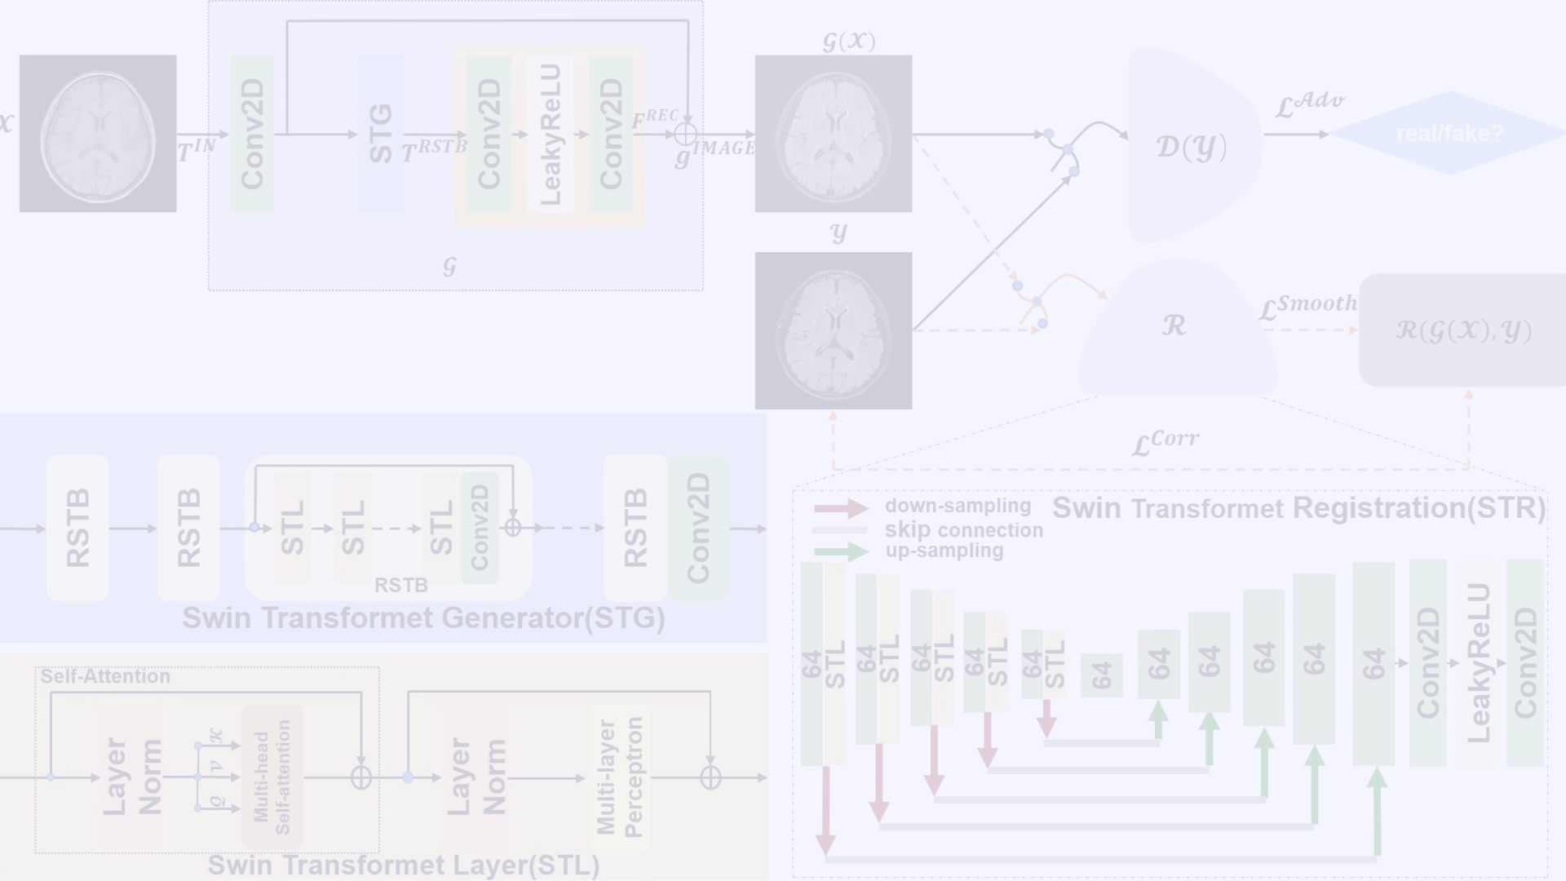



Architecture of the GAN model for MRI Image Generation
Generator Network
Discriminator Network
Adversarial Training
Creates artificial MRI images from random noise input.
Assesses the generated images and distinguishes them from real MRI images.
The generator and discriminator are trained against each other, leading to improved generation quality over time.

Slide 8
Overview of the modified U-Net architecture
High Resolution Features
Efficient Information Flow
Contextual Information Integration
The modified U-Net architecture is designed to capture high-resolution features essential in MRI image generation.
It ensures efficient flow of information through the network, enhancing the quality of generated images.
The architecture adeptly integrates contextual information to produce accurate and reliable MRI images.

Slide 9


Slide 10
Training process and optimization methods
1
2
3
Epochs
Learning Rate
Loss Functions
Iterations of training on the entire dataset. Larger epochs can lead to more accurate results.
Controls the step size during the optimization process. Optimal rates are crucial for convergence.
Used to quantify the difference between the generated and real MRI images. Lower losses signify better performance.

Slide 11
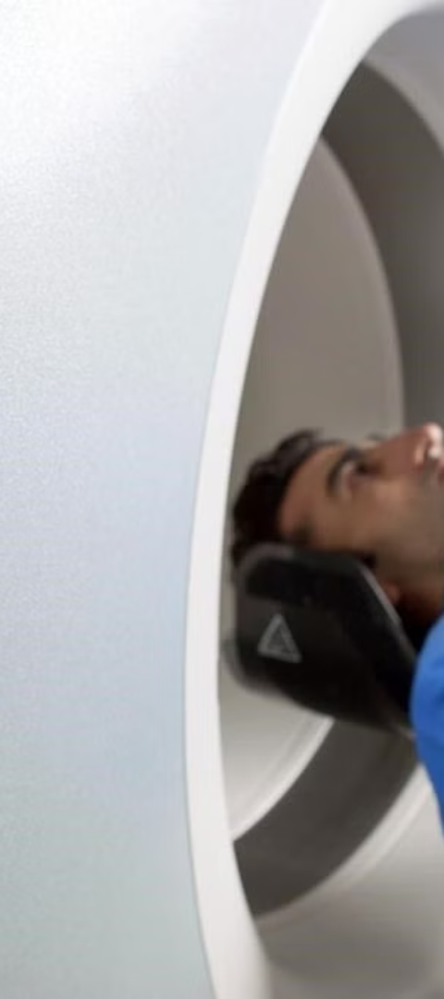
Evaluation metrics for assessing the quality of generated images
SSIM (Structural Similarity Index)
PSNR (Peak Signal-to-Noise Ratio)
Measures the similarity between the generated and real MRI images, focusing on structural details.
Evaluates the image quality by comparing the peak signal power with the power of corrupting noise.
MAE (Mean Absolute Error)
Quantifies the average difference between pixel values of the generated and real images.

Slide 12
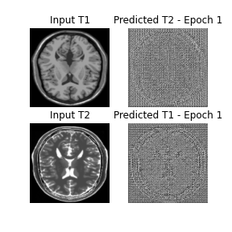
Visualization of Results

Slide 13



Future directions and potential applications of the model
Medical Imaging
Research Advancements
Technological Innovation
Enhancing diagnostic imaging and aiding in medical research and treatment development.
Improving the quality and quantity of MRI data available for scientific studies and discoveries.
Pushing boundaries in AI-generated visual content and image processing technologies.

